Slide 1
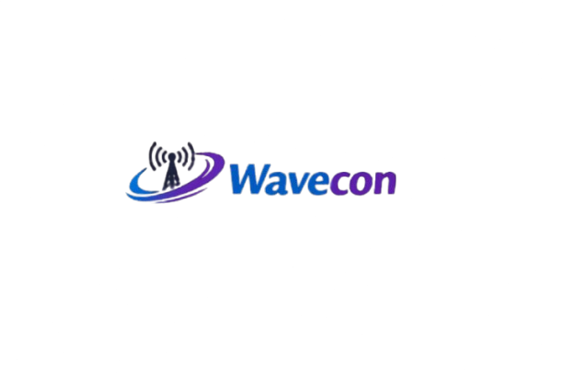





Wavecon 5G Impact Analysis
5G launch has reshaped Wavecon’s performance landscape
This deck highlights revenue impact, KPI shifts, and plan performance
Provides recommendations for plan continuation, redesign, or discontinuation
Objective: Enable data‑driven decisions for sustainable growth
REVENUE
KPIs
PLAN
STRATEGY

Slide 2


Key Insights Post- 5G Launch
ARPU vs Revenue
User Churn
City Polarization
Plan Performance
Strategic
Recommendations
ARPU Surge Despite
Revenue Dip
Average Revenue Per User increased by 11.05%, but total revenue declined by -0.50%, indicating user churn offset gains.
Active Users Dropped by 8.28%
Total Active Users fell from 84.4M to 77.4M, making it the most underperforming KPI post-5G.
Cities like Lucknow (+1.82%) and Gurgaon (+1.51%) showed strong growth, while Delhi (‑2.83%) and Chennai (‑2.59%) declined.
Strong performers: p1, p11, p12
Mid‑tier stable: p2, p3
Weak contributors: p4–p7,p13
👉 Recommendation: Retain & promote p1, p11, p12; and discontinue weaker ones.
Strategic Action Needed
Plans in Pune and Mumbai show misalignment between user growth and revenue. Recommend redesign or discontinuation based on margin analysis.

Slide 3


Revenue Performance Before vs After 5G
Total Revenue
City-level Highlights
Before 5G → ₹15.98 bn
After 5G → ₹15.89 bn
Change: -0.50%
Positive Growth
Lucknow (+1.82%)
Gurgaon (+1.51%)
Patna (+1.48%)
Raipur (+1.15%)
Jaipur (+0.98%)
Negative Growth
Delhi (-2.83%)
Chennai (-2.59%)
Ahmedabad (-2.02%)
Hyderabad (-1.29%)
Chandigarh (-0.55%)
Monthly Average Revenue: ₹4.0 bn

Slide 4

Revenue Performance
INSIGHTS
Revenue overall is flat to slightly negative, despite ARPU (Avg. Revenue/User) gains.
Metro cities (Delhi, Chennai, Ahmedabad) are dragging performance.
Tier-2 cities (Lucknow, Gurgaon, Patna) are showing resilience and growth.
Indicates urban churn vs regional adoption trend.

Slide 5
USER Performance Before vs After 5G
Before 5G → 84.4M
After 5G → 77.4M
Change: -8.28%
Churn Impact :
Total Active Users (TAU)
Despite ARPU growth (+11.05%), the loss of ~7M users offset revenue gains.
Indicates customer dissatisfaction or competitive migration.

Slide 6
USER Performance
INSIGHTS
TAU (Total Active Users) decline is the most underperforming KPI post‑5G.
Suggests pricing, plan design, or network rollout issues in major metros.
Retention strategies are critical: loyalty offers, bundled services, or targeted marketing.

Slide 7
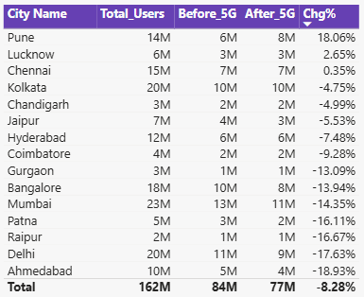

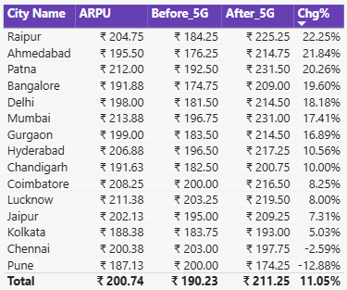
CITY-WISE Performance POST 5G
Total Active Users (TAU)
Average Revenue per User (ARPU)
Mixed Signals
Pune → Users ↑ (+18.06%) but
ARPU ↓ (-12.88%)
Mumbai → ARPU ↑ (+17.41%) but
Users ↓ (-14.35%)

Slide 8
CITY-WISE Performance
INSIGHTS
Tier-2 cities are driving growth and adoption.
Metro cities are struggling with churn and declining KPIs.
Pune and Mumbai show misalignment between user growth and revenue, requiring plan redesign or discontinuation.
Indicates regional adoption vs urban resistance trend.

Slide 9
ACTION PLAN POST 5G INSIGHTS
RETAIN & STRENGTHEN
HIGH PERFORMING PLANS
REDESIGN MISALIGNED PLANS
Pune: High user growth but low ARPU → Adjust pricing/benefits to improve margins.
Mumbai: High ARPU but declining users → Introduce retention offers and competitive bundles.
Continue plans in Lucknow, Patna, Gurgaon, Raipur where adoption and revenue are growing.
Invest in marketing and network expansion in these regions.
ADDRESS METRO CHURN
FOCUS ON KPI RECOVERY
Delhi, Chennai, Ahmedabad, Hyderabad show steep declines.
Conduct churn analysis (pricing, competition, service quality).
Launch targeted loyalty programs.
TAU dropped by 8.28% → Prioritize customer retention strategies.
Bundle services (data + OTT), improve customer experience, and reduce churn drivers.

Slide 10

PLAN Performance POST 5G
Flagship Plan (p1 – Smart Recharge Pack, 2 GB/Day, 3 months)
Revenue Before 5G: ₹1.8bn
Revenue After 5G: ₹2.4bn (+33% growth)
Monthly Trend (Jan–Apr): Stable ~₹396M → ₹503M → ₹466M → ₹448M
Top Cities: Mumbai (₹0.25bn), Kolkata (₹0.22bn), Delhi (₹0.21bn), Bangalore (₹0.20bn), Chennai (₹0.18bn)
Insight: Clear winner post‑5G, strong adoption across metros.
Action: Retain and promote aggressively.

Slide 11
POST 5G PLAN STRATEGY
PERFORMING WELL
(RETAIN & PROMOTE)
WEAK CONTRIBUTORS
(STREAMLINE/DISCONTINUE)
DISCONTINUED PLANS
(POST-5G)
p1 (Smart Recharge Pack, 2 GB/day, 3 months): Revenue surged from ₹1.8bn → ₹2.4bn (+33%).
p11 & p12: Consistent strong performers (~₹480M and ₹300M/month).
p2 & p3: Mid‑tier but stable (~₹350M/month).
✅ Action: Continue and promote these plans as growth drivers.
p4–p7: Small revenue (~₹200M or less/month).
p13: Niche plan, stable but very low (~₹80M/month).
⚠️ Action: Consider bundling or discontinuation to focus resources on high‑impact plans.
p8, p9, p10 → Discontinued due to:
Low revenue contribution (combined <5% of monthly revenues).
No growth post‑5G — stagnated while flagship plans grew.
Mismatch with 5G demand — customers shifted to larger, bundled packs.
❌ Operational streamlining — removing weak plans simplified the portfolio.

Slide 12
THANK YOU
“Wavecon remains committed to delivering value through innovation, connectivity, and customer focus in the 5G era.”
– Prashant Kumar Sahoo

